Slide 1

XiaoR Geek raspberry pie primary course 4
--How to use the machine car
深圳市小二极客科技有限公司
www.wifi-robots.com

Slide 2
catalog
1. start the machine car
2. PC-side control software instructions
3. Mobile phone APP instructions

Slide 3
1. start the machine car
Start the car, the boot process is about 30S. After the completion of the start will appear 'wifi-robots ...' wifi signal. If the servo back angle is too large, please unplug the servo wiring, using the app control and then plug in.

Slide 4
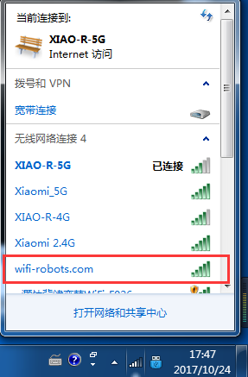
2. PC-side control software instructions
After the car starts, use the computer to search wifi signal, find wifi-robots .. at the beginning, and then click on the link, wifi password 12345678

Slide 5
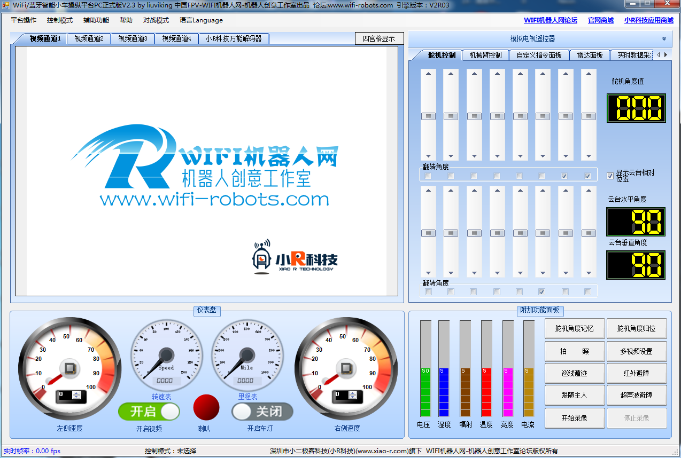
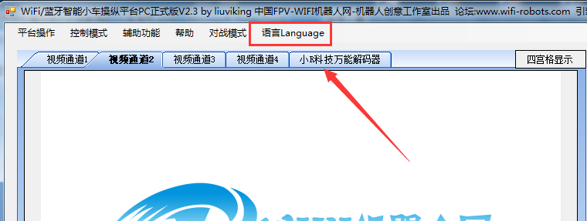
Click on the software, the language of the software can switch
to foreign customers ands witch to English.

Slide 6
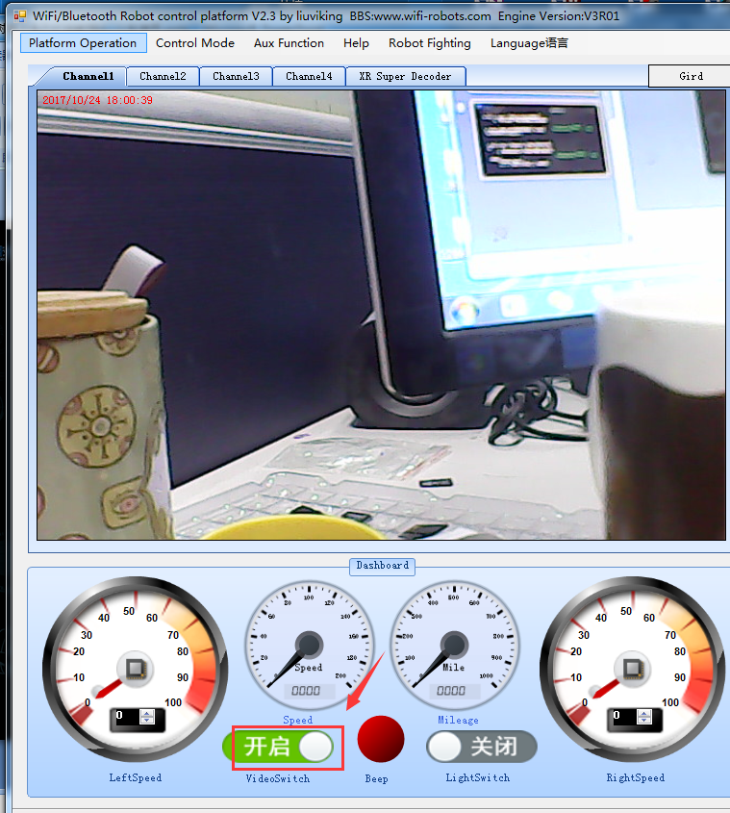
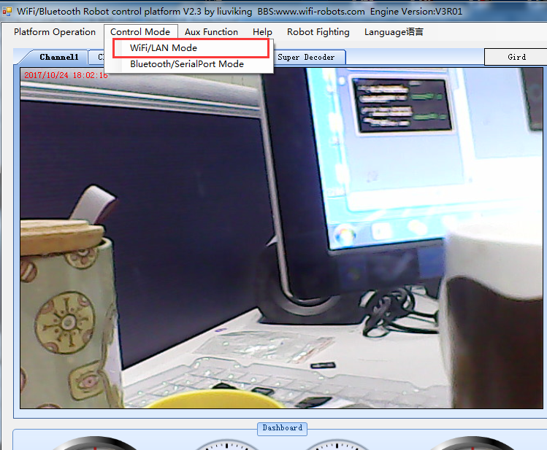
Control the video switch via the Videoswitch
Control mode selection wifi control

Slide 7
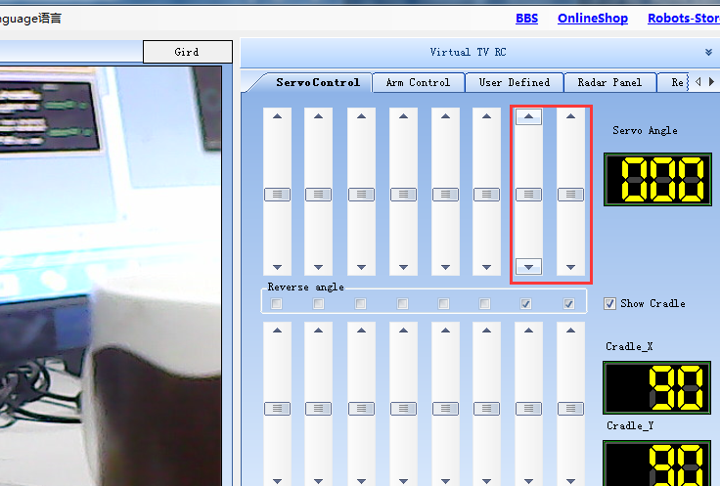

These two sliders can control the camera, keyboard W, S, A, D, control the robot all around respectively
Here you can lock the servo ongle,
The next time you boot to the current location

Slide 8
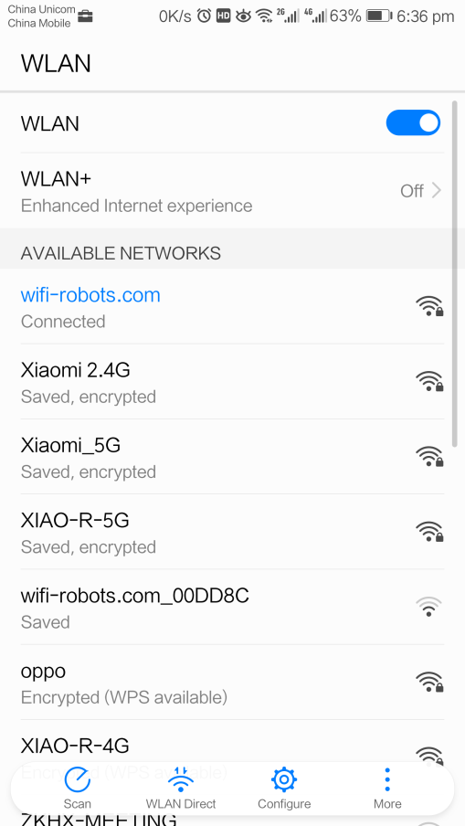
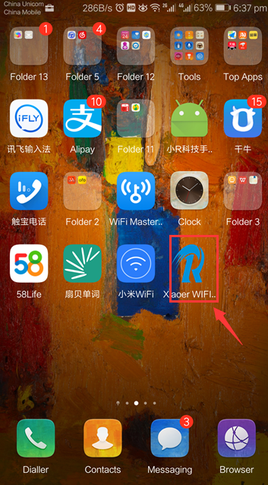
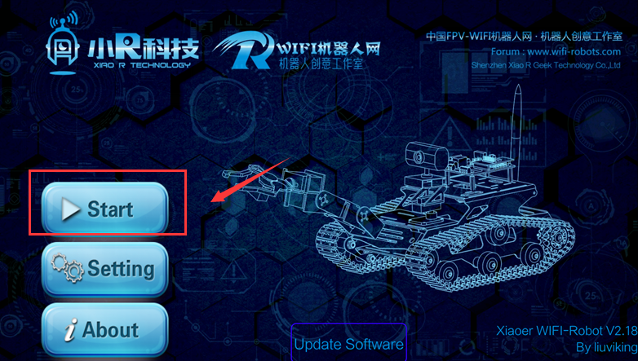
3. Mobile phone APP instructions
1. search wifi
click on APP
click on Start

Slide 9
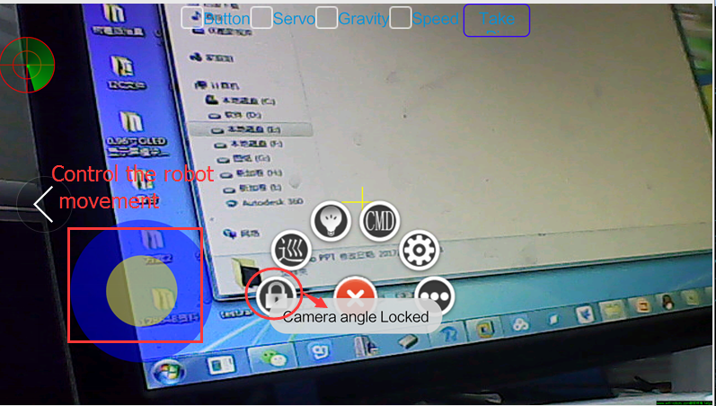
Slide the screen to control the servo

